Slide 1
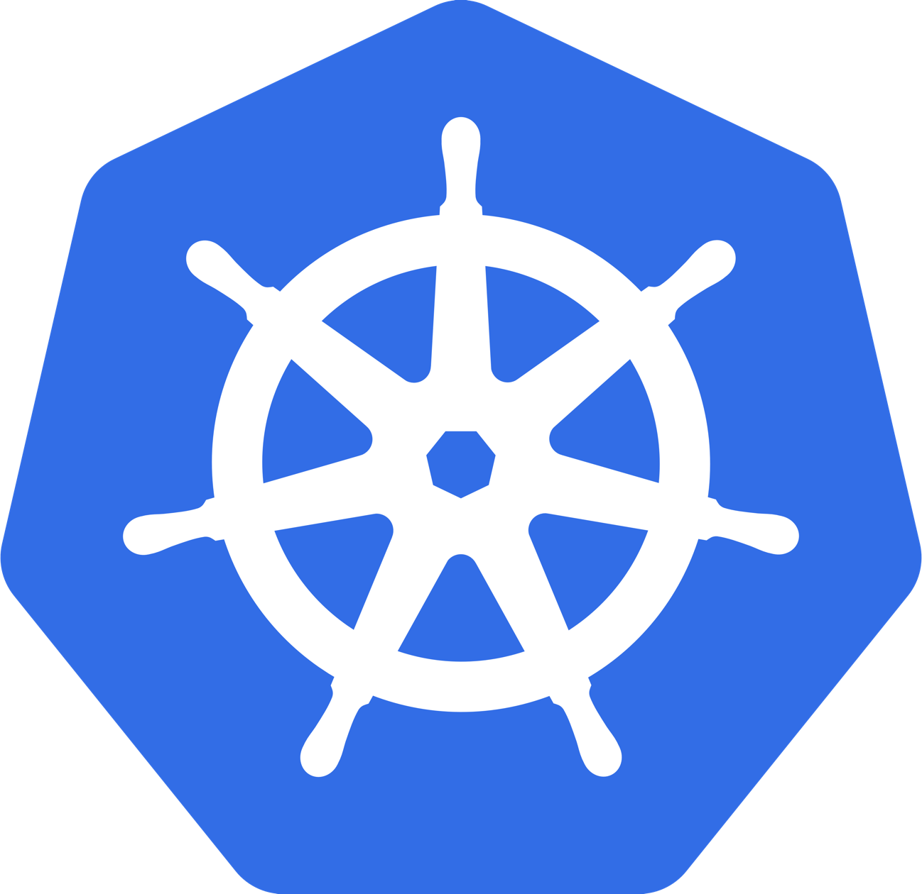
Kubernetes Workshop
Hands-on with Kubernetes and Amazon EKS
David Pate

Slide 2


Speaker Bio
David Pate
Specialist Master | Core Business Operations – Cloud Engineering
Email: davpate@deloitte.com
Bio: David is a software engineer who has been deploying production workloads on AWS for the last 7 years, and production workloads in Kubernetes for almost 4 years. In the past David has led development teams at Enterprises and Startups focusing mainly on AWS, Kubernetes, Docker, Node.js, and Java.
Fun Fact: For my 18th birthday my mom gave me a Ribbon that said “You’re Special”, when I asked her why she just said “Because you are”.
Gary Arora
Manager | Core Business Operations – Cloud Engineering
Email: garyarora@deloitte.com
Bio: Gary is a developer advocate for all things cloudnative, serverless, and opensource. He has started many (and finished some) pet projects using cloud, IoT (Raspberry Pi) , and machine learning as a full-stack developer with an unapologetic bias for Node.js, and React.
Fun Fact: I discovered breakfast cereal a few years ago and now can’t live without it.

Slide 3
Table of Contents
Kubernetes Workshop
01
Kubernetes (k8s) Basics
What is Kubernetes?
Kubernetes Nodes & Objects
02
Kubernetes Architecture
Kubernetes Control Plane
Kubernetes Data Plane
03
Amazon EKS
Amazon EKS Architecture
Other Flavors of Kubernetes
04
Hands-On Activities
Deploy the Kubernetes Dashboard
Deploy an Example Microservices Application
Add Liveness and Readiness Checks for an App
Auto-Scaling our Pods and Nodes

Slide 4
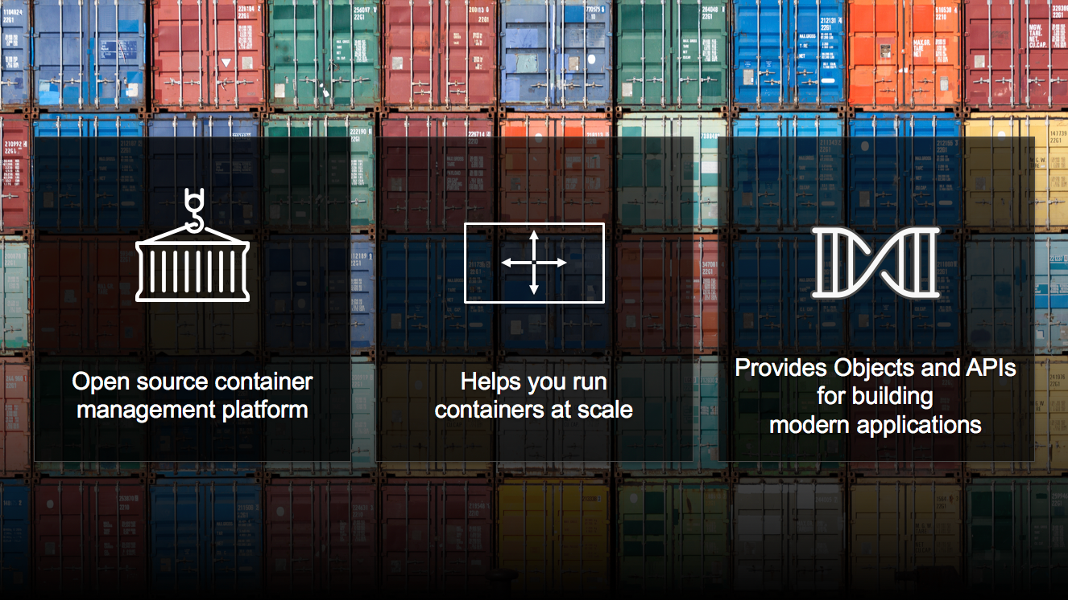
Kubernetes Basics
Kubernetes Architecture
Amazon EKS
Hands-On Activities
What is Kubernetes?

Slide 5
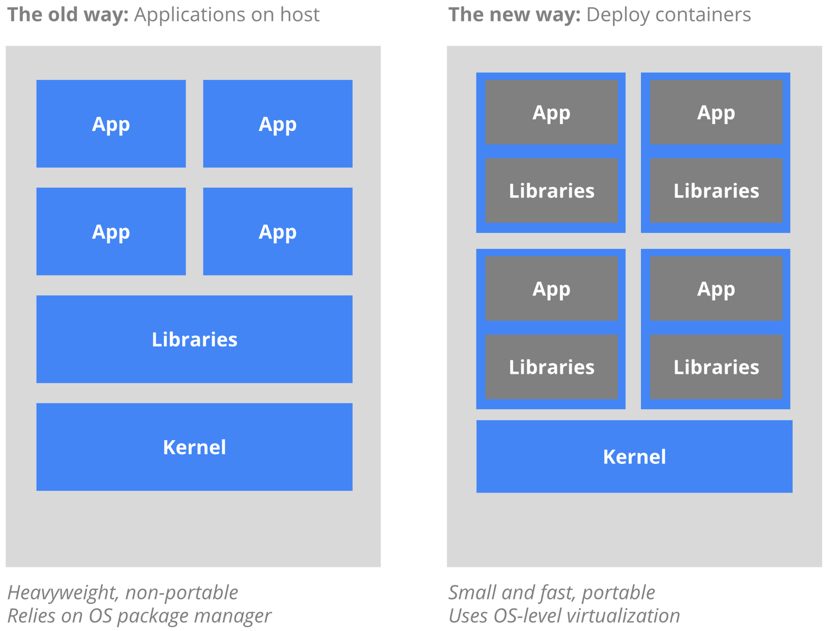
Why Containers?
Old Way vs. New Way
Increased Agility and efficiency of creation and deployment compared to VMs.
Enabled separation of concerns through immutable builds and decouple of applications & infrastructure.
Improved observability through OS-level and application health as well as other signals.
Environmental consistency
Cloud & OS portability
Application-centric management
Resource Isolation
Improved utilization through high efficiency and density

Slide 6

Kubernetes Basics
Nodes in Kubernetes
The machines that make up a cluster in Kubernetes are called nodes.
Nodes in a Kubernetes cluster may be physical or virtual.
There are two types of nodes in Kubernetes:
A Master Node type, which is the “brains” of the operation and makes up the Control Plane.
A Worker Node type, which runs the actual containers (via pods) and makes up the Data Plane.

Slide 7

Kubernetes Basics
Objects in Kubernetes
Objects in Kubernetes are entities which are used to represent the state of the cluster.
An Object is a “record of intent” – once created, the cluster does its best to ensure it exists as defined. This is known as the cluster’s “desired state”.
Kubernetes is always working to make an object’s “current state” equal to the object’s “desired state”. A ”desired state” might be:
What pods (containers) are running, and on which nodes
IP endpoints that map to a logical group of containers
How many replicas of a container are running

Slide 8
Types of Kubernetes Objects
Pod
A thin wrapper around one or more containers and the smallest deployable units of computing that can be created and managed in Kubernetes.
DaemonSet
Ensures that all (or some) Nodes run a copy of a Pod.
Deployment
Details how to roll out (or roll back) across versions of your application running as a Pod or ReplicaSet.
ReplicaSet
Ensures a defined number of pods are always running.
Job
Creates one or more Pods and ensures that a specified number of them successfully terminate.
Service
Maps a fixed IP address or Load Balancer to a logical group of pods.
Ingress
Ensures that HTTP/S traffic from outside the cluster is able to be routed to Services inside the cluster.
Label
Key/Value pairs used for association and filtering.

Slide 9

Kubernetes Architecture
Kubernetes Basics
Kubernetes Architecture
Amazon EKS
Hands-On Activities

Slide 10
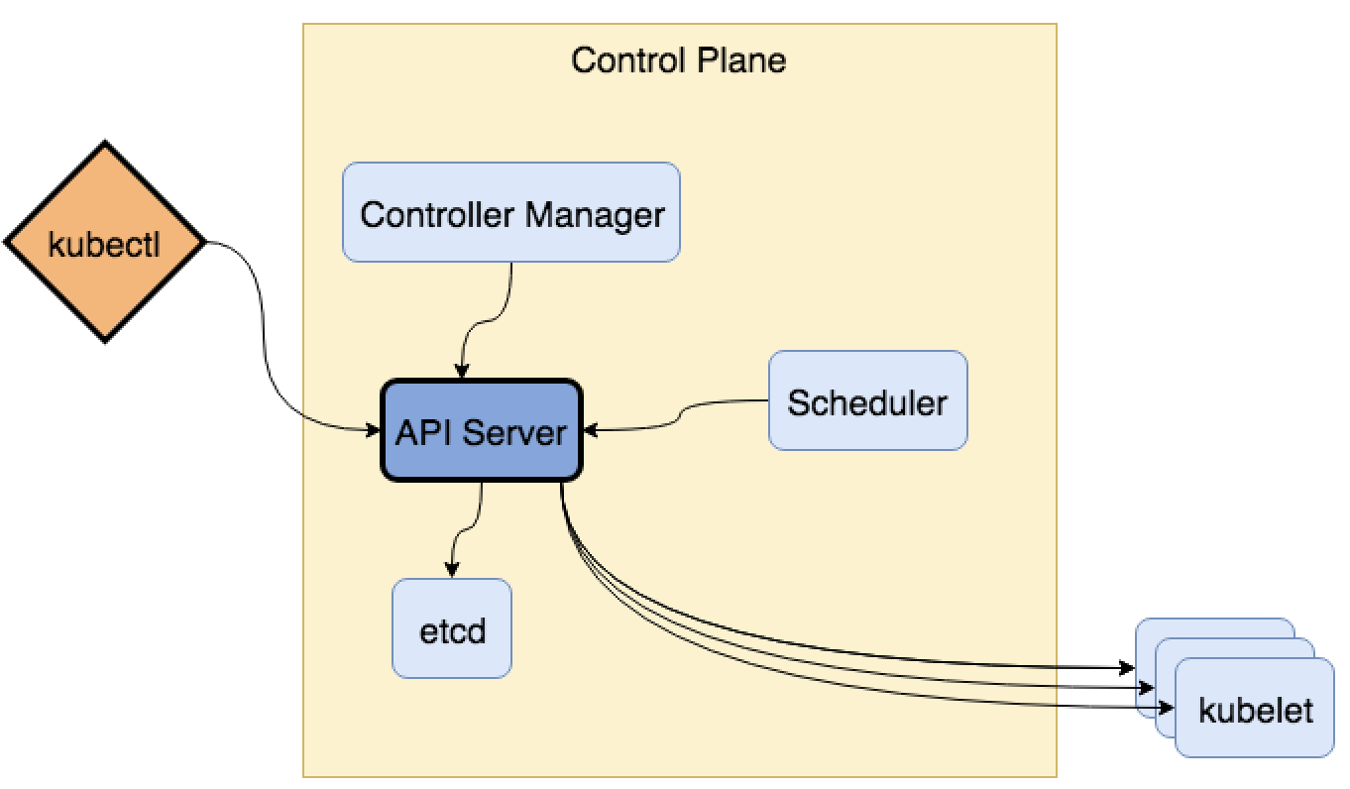
Control Plane
Runs on all Nodes of the Master type, responsible for maintaining the desired state for the cluster.
Consists of one or more API Servers which used for the REST API and Kubectl. With the following components:
Etcd – Distributed key/value store used for all cluster data.
Controller Manager – Contains separate controllers which always evaluate the current vs. desired state.
Node Controller – Notices and responds when nodes go down.
Replication Controller – Ensures the correct number of pods for every replication controller.
Endpoint Controller – Joins Services and Pods using the Endpoints object.
Service Account & Token Controllers – Creates default accounts and API tokens for namespaces.
Scheduler – Which schedules pods to run on workers.

Slide 11
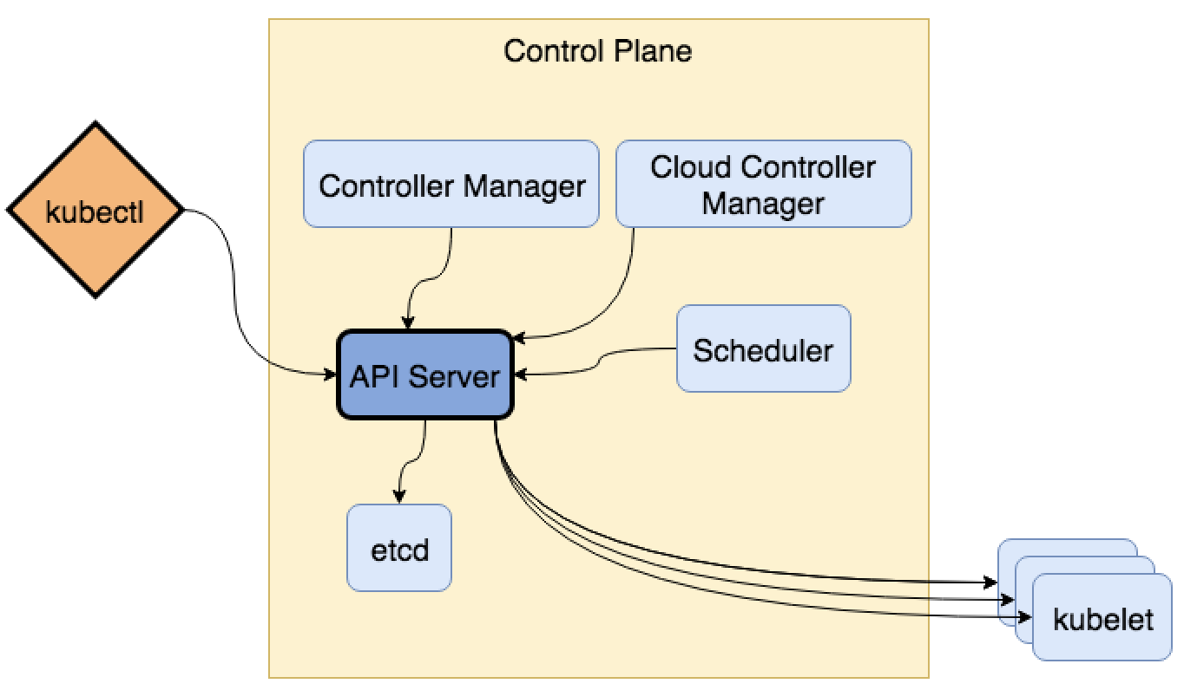
Control Plane on the Cloud
Additional components when running on a cloud provider.
When operating in the Cloud there is a platform specific Controller Manager that also runs, described below.
Cloud Controller Manager – Contains separate controllers specific to the Cloud provider which always evaluate the current vs. desired state.
Node Controller – Monitors Nodes in the cloud provider to determine if a node has been deleted in the cloud after it stops responding.
Route Controller – Sets up routes in the underlying cloud infrastructure.
Service Controller – Maintains cloud provider load balancers
Volume Controller – Orchestrates cloud provider volumes

Slide 12
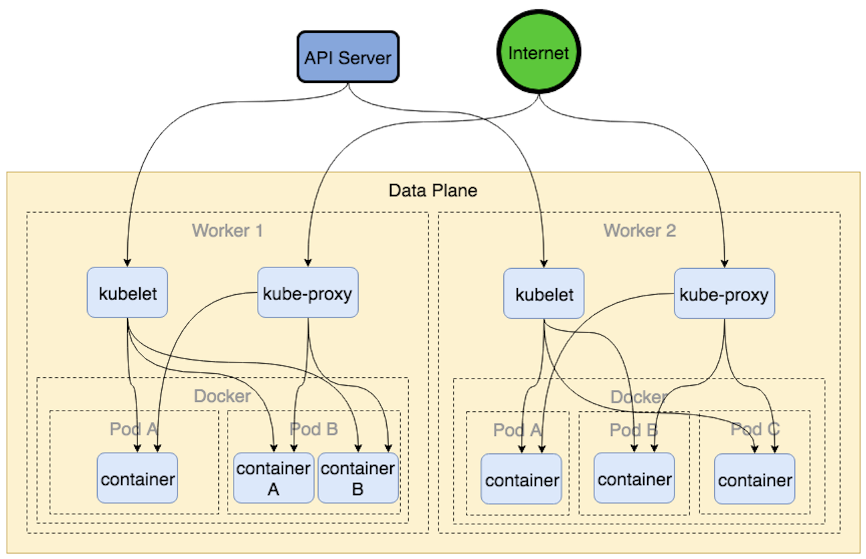
Data Plane
Runs on all Nodes of any type, responsible for running Pods and providing the Kubernetes environment
The Data Plane maintains running Pods and provides the Kubernetes runtime environment.
It is made up of the following components:
Kubelet – An agent that runs on each Node and makes sure that containers are running in a pod.
Kube-proxy – Manages IP translation and routing.

Slide 13
Addon Components
Addons are pods and services that implement additional cluster features.
DNS – Enables services to lookup other services by Pod name and other identifiers. (ie. CoreDNS)
Kubernetes Dashboard – Helps with managing and troubleshooting applications and clusters.
Container Resource Monitoring – Provides performance insights into container resource usage and other metrics.
Cluster-Level Logging – Provides central location for application and cluster logs.

Slide 14
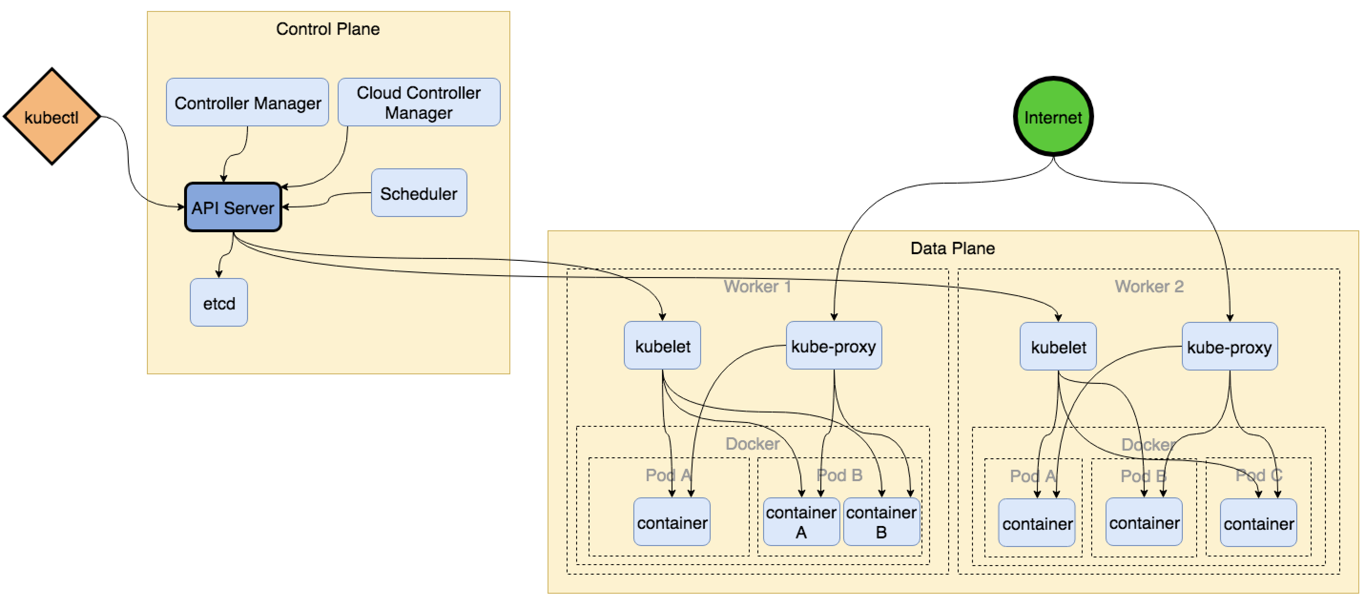
Kubernetes Architecture Overview

Slide 15

Kubernetes Cluster Setup
Launching a Cluster
We’re going to be using eksctl created by WeaveWorks to launch out cluster today, but there are many other tools that we could use instead to launch and configure a self-managed Kubernetes cluster:
Minikube – used to run Kubernetes locally.
Kops – helps to create and manage Kubernetes clusters from the command-line on various platforms.
Kubeadm – helps to bootstrap a minimum viable Kubernetes cluster with best practices baked in.
And many others.

Slide 16

Amazon EKS
Kubernetes Basics
Kubernetes Architecture
Amazon EKS
Hands-On Activities

Slide 17
What is Amazon EKS?
A managed control-plane.
You
Amazon EKS provides a managed control-plane which is:
Highly available with Master nodes spread across multiple Availability Zones.
Able to automatically detect and replace unhealthy Master nodes
Simplify upgrades and patching with on-demand managed updates
Secure by default providing encrypted communication channels between Master and Worker nodes
Data Plane
Control Plane

Slide 18
A Look at Managed Kubernetes Providers
Feature Comparison
Feature
Regions Supported | Select Regions Worldwide (No GovCloud) | Worldwide | Worldwide
Managed Control Plane? | √ | √ | √
Control Plane HA? | √ | √ | X
Cluster Creation Time | 15-20 mins | ~3 mins | 20 mins
Managed Worker Nodes? | X | √ | √
Worker Node HA? | √ | √ | √
Google GKE
Azure AKS

Slide 19
A Look at Managed Kubernetes Providers
Feature Comparison
Feature
Worker Node GPU Support? | √ | √ | √
Maximum Pods per Node | Limited by Instance Type (largest is 734) | 100 | 110
Maximum Nodes per Cluster | 500+ | 5000 | 100
Bare Metal Nodes? | √ | X | X
Kubernetes Upgrades? | N/A | Automatic or On-Demand | On-Demand
Control Plane Costs | 20 cents/hr per cluster | Free | Free
Google GKE
Azure AKS

Slide 20

Hands-On Activities
Kubernetes Basics
Kubernetes Architecture
Amazon EKS
Hands-On Activities

Slide 21
Hands-On Activities Overview

Slide 22
Workshop Materials – Section 1
We will be launching our EKS Cluster and Worker Nodes and validating them.
Go To: http://davpate-eksworkshop.s3-website-us-east-1.amazonaws.com
And Complete Section 1, following that complete Section 2

Slide 23
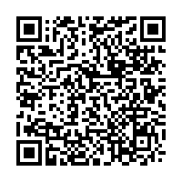

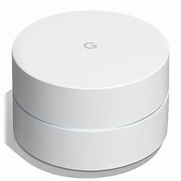
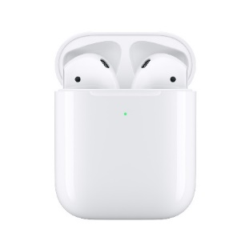
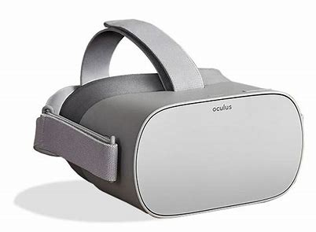
Kubernetes Technical Workshop
Enter to Win
tinyurl.com/kubernetesK8
Visit the link above to:
Capture your attendance
Fill out a brief feedback survey on this breakout session
Every time you submit the survey, you receive an additional entry for a chance to top the leaderboard and win great prizes during the summit close!
Q&A

